Slide 1
Problem Statement: Explore how consumer and loan attributes influence loan default for a consumer finance company. Mitigate the risks associated with loan approval decisions: the risk of losing business by not approving loans from likely repayers and the risk of financial loss from defaulters. Utilize EDA techniques to identify patterns and key variables indicating default, enhancing portfolio management, and minimizing credit loss. The goal is to leverage risk analytics to make informed lending decisions, reduce credit loss, and improve overall risk assessment.

Slide 2
Analysis Approach: The analysis approach involves loading and exploring the loan dataset, performing univariate and bivariate analyses, calculating key performance indicators, exploring relationships between variables, and presenting insights through visualizations. The goal is to understand loan status distribution, identify driving factors, and provide business-relevant insights. The results are presented using various plots and metrics.

Slide 3
Business Insights from Analysis: Univariate analysis Loan Status Distribution.
The loan portfolio is generally healthy, with a high percentage (83%) of loans fully paid. However, there is a notable fraction (14%) marked as charged off, indicating a potential default risk. The company should closely monitor and assess factors contributing to charged-off loans to minimize default rates.
Loan Status Distribution: loan status
Fully Paid 0.829620 Charged Off 0.141677 Current 0.028703

Slide 4
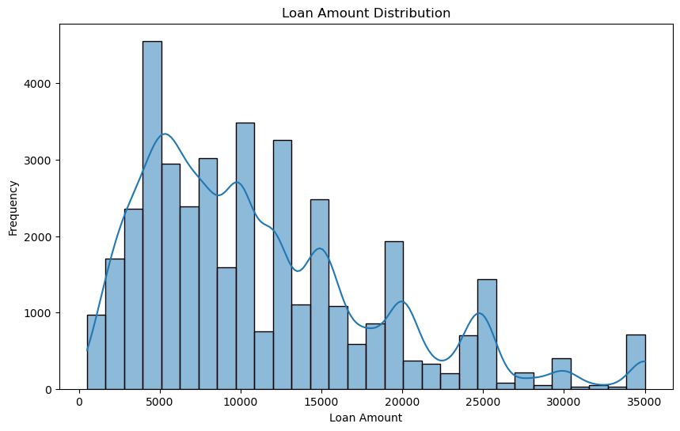
Loan Amount Distribution:
The loan distribution peaks at 5000 to 10000, suggesting a preference for smaller loan amounts. Peaks at 5k and 10k indicate common amounts, reflecting specific financial needs.

Slide 5
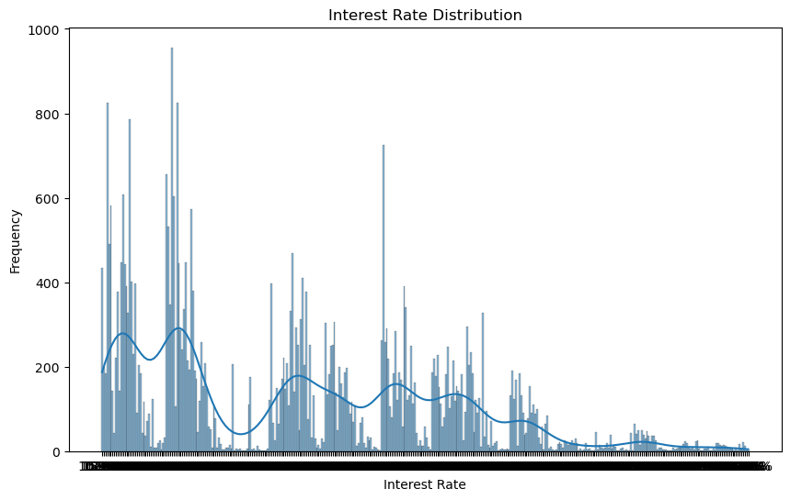
Interest Rate Distribution:
Analyzing the interest rate distribution helps in understanding the cost of borrowing. The interest rate distribution reveals a higher frequency in the range of 200 to 400, indicating a common interest rate range. As interest rates increase or decrease beyond this range, the frequency gradually decreases.

Slide 6
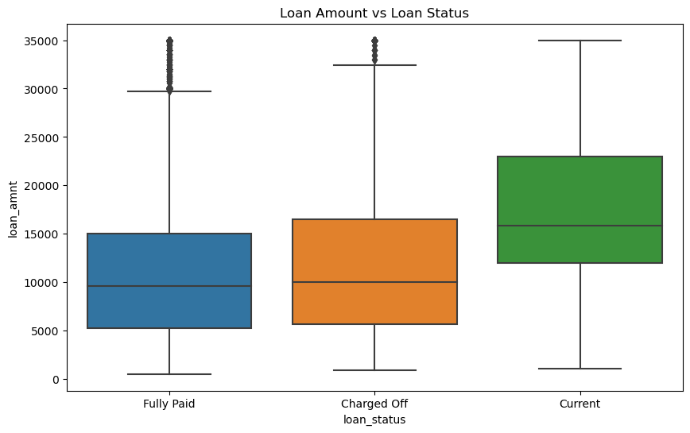
Bivariate analysis Loan Amount vs. Loan Status:
.
A boxplot is used to explore the relationship between loan amounts and loan status. Charged Off loans typically have higher median and maximum loan amounts, indicating potential risk in larger loans. Fully Paid loans tend to have lower median and maximum loan amounts, suggesting successful repayment. Current loans show a broader range of loan amounts, reflecting ongoing variability in amounts.

Slide 7


Key point Indicators
Loan Approval Rate: 82.96%
Default Rate: 14.17%
Average Loan Amount: $11,219.44
Average Debt-to-Income (DTI) Ratio: 0.02%
Repayment Rate: 82.96%
Insight: The high loan approval rate and low default rate suggest effective risk assessment and management. The average loan amount provides insights into customer preferences. A low average DTI ratio indicates manageable debt levels for borrowers. The matching repayment and approval rates indicate a consistent performance in loan repayment.

Slide 8
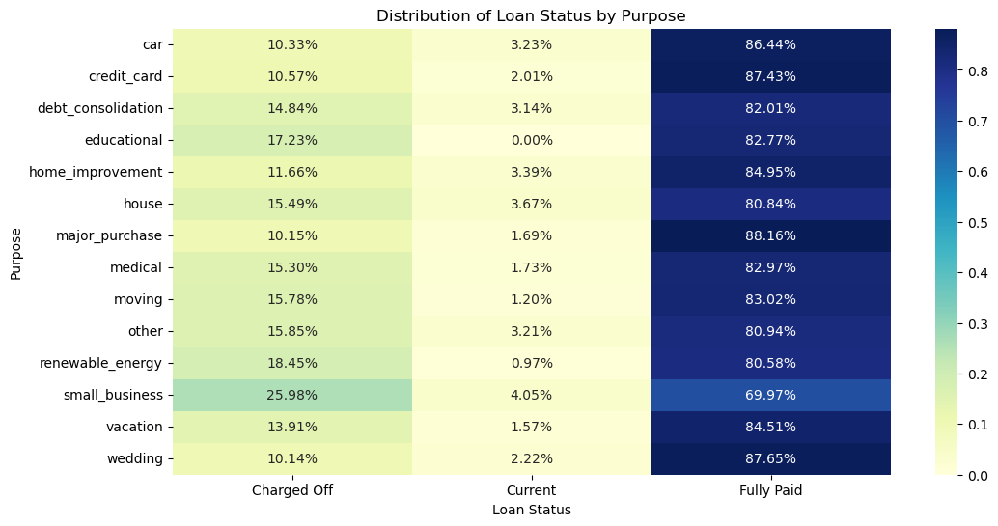
Additional Analysis
Distribution of loan status by purpose
The charged-off rate is highest for small business loans, followed by renewal energy and educational purposes. Current status is highest for small business loans, while fully paid status is highest for wedding, credit card, and car purposes.

Slide 9
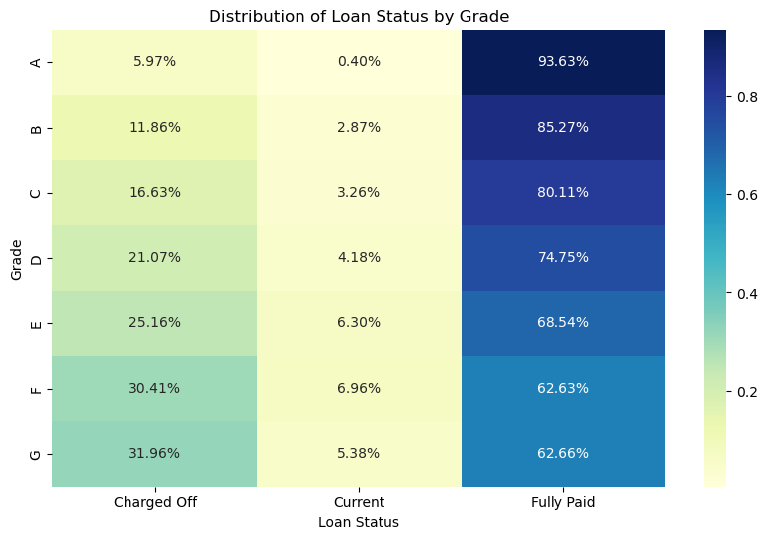
Additional Analysis
Distribution of loan status by Grade
Borrowers with higher grades (e.g., Grade A) have a higher likelihood of fully repaying their loans, while those with lower grades (e.g., Grade G) are more likely to default. The distribution patterns suggest a correlation between borrower grades and loan status outcomes.

Slide 10
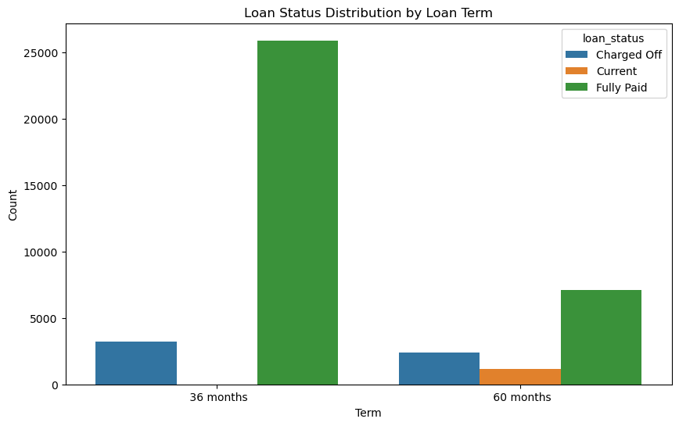
Additional Analysis
Loan Status Distribution by loan term
The loan status distribution by loan term shows that, for both 36-month and 60-month terms, the majority of loans are fully paid. However, the count of charged-off loans is higher for the 60-month term, suggesting a potential higher risk associated with longer-term loans. Additionally, there are current loans only in the 60-month term, indicating ongoing loans with pending status.

Slide 11
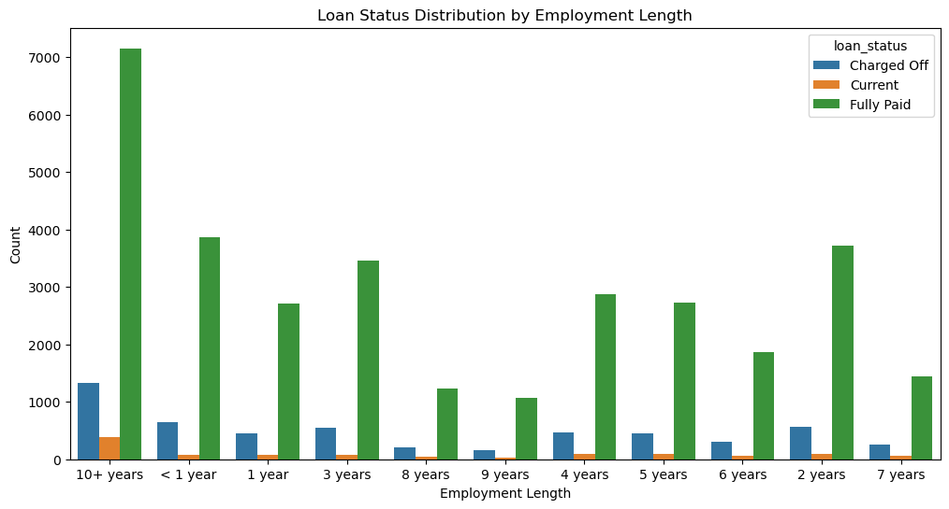
Additional Analysis
Loan Status Distribution by Employment Length
The analysis of loan status distribution by employment length indicates that borrowers with longer employment histories, especially 10+ years, tend to have higher fully paid loan counts. However, even for longer employment lengths, there are instances of charged-off loans, indicating that employment history alone does not guarantee loan repayment. Borrowers with shorter employment lengths, particularly less than 1 year, exhibit higher charged-off counts, suggesting increased risk for default in this category.

Slide 12
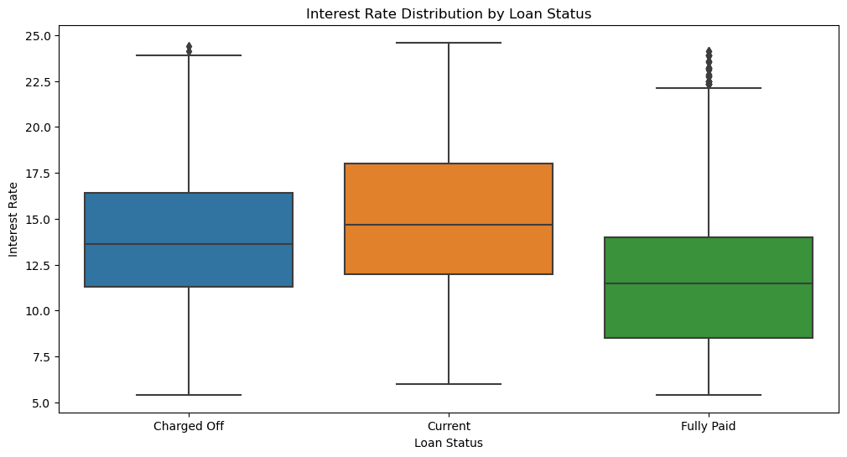
Additional Analysis
Interest Rate distribution by Loan Status
The analysis of interest rate distribution by loan status indicates that charged-off loans generally have higher median and maximum interest rates compared to fully paid loans. Current loans show a broader distribution of interest rates.

Slide 13
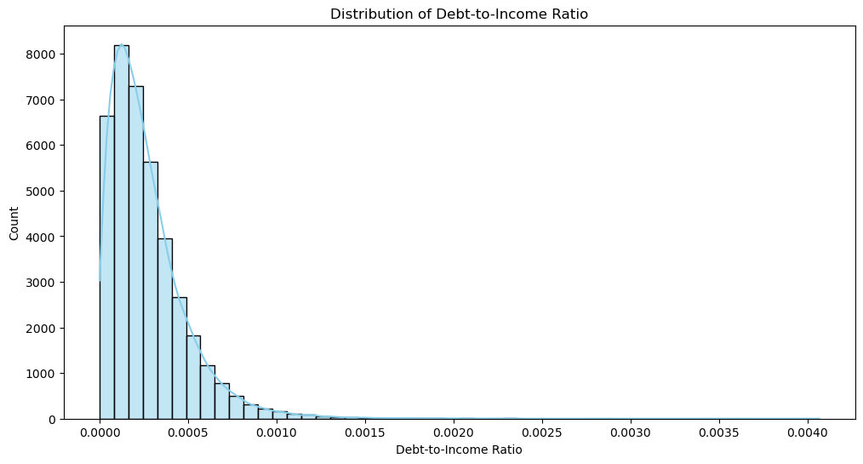
Additional Analysis
Distribution of Debt to Income Ratio
The distribution of debt-to-income (DTI) ratios shows a concentration of counts at lower DTI values, suggesting that many borrowers have lower levels of debt relative to their income.

Slide 14
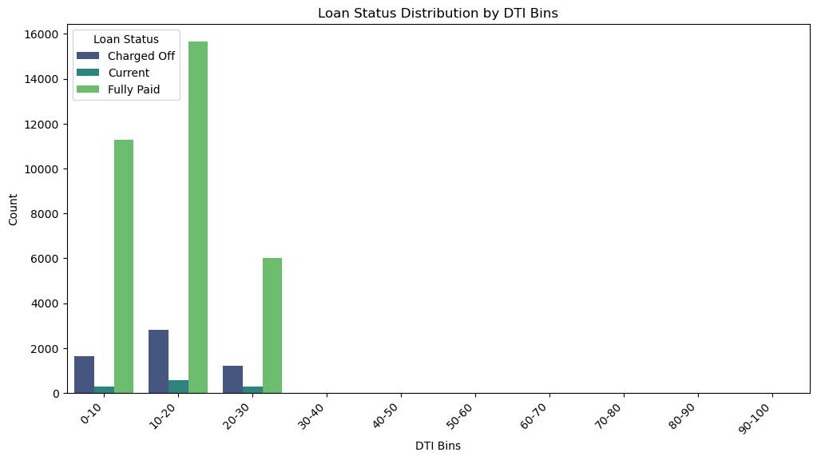
Additional Analysis
Loan Status Distribution by DTI Bins
The insight is that borrowers with lower debt-to-income (DTI) ratios, especially in the 0-10 and 10-20 bins, have a higher likelihood of fully paying off their loans. As DTI increases, the count of fully paid loans decreases, and there is no data available for DTI bins beyond 30-40.

Slide 15
Conclusion
Risk Mitigation Strategies: Implement targeted risk mitigation strategies for loans with higher risk factors, such as those associated with small business, longer loan terms, and specific employment lengths.
Portfolio Diversification: Diversify the loan portfolio to reduce concentration risk. This can involve spreading loans across different purposes, grades, and terms to ensure a more balanced and resilient portfolio.
Credit Scoring Enhancement: Enhance the credit scoring model to better incorporate identified driver variables, such as purpose, grade, and employment length, ensuring a more accurate assessment of borrower risk.
Targeted Marketing and Education: Conduct targeted marketing and educational campaigns for borrowers in higher-risk categories. This can include providing resources on financial literacy and responsible borrowing practices.
Continuous Monitoring: Implement a robust system for continuous monitoring of the loan portfolio. Regularly update risk assessments based on changing market conditions, economic indicators, and borrower behavior.
Customer Support and Assistance: Provide proactive customer support and assistance to borrowers facing financial challenges. Establishing a communication channel can help address issues before they escalate.
By incorporating these solutions, the company can proactively manage and mitigate default risks, enhance the overall health of its loan portfolio, and ensure a sustainable and profitable lending business.
Thank you for your time and attention.
Priyanka Mukkavilli a
Email id: priyankavenkata77@gmail.com

